Slide 1
January 2025 Updates to Oregon REALTORS® Forms
Update 2025-1

Slide 2
2025 Updates
FORMS W/MAJOR UPDATES
4.4A Delivery/Receipt of Association Documents
[New] 4.5 Short Sale Addendum
2.10 Contingent Right to Purchase
FORMS W/MINOR UPDATES
1.1-1.5 Sales Agreements
2.11 Notice of Intent
4.4 Association Addendum
9.3-9.4A Representation & Non-Agency Agreements
9.11 Referral Agreement
10.1 & 10.2 Advisories
Updates to Oregon REALTOR® Forms come from several sources:
User comments
Forms Forums
Principal Broker Forums
Forms Task Force input
Attorney review

Slide 3
Major Update – 4.4A Delivery & Receipt of Association Documents
Streamlined ability to explain that requested Association documents do not exist.

Slide 4
Major Update – 4.4A Delivery & Receipt of Association Documents
Checkbox option given to state “document does not exist”.

Slide 5
Major Update – 2.10 Contingent Right to Purchase Addendum
If property already under contract at time Contingent Right is signed, there is no purpose to the Section 4 Contingency Deadline, form modified to reflect that.

Slide 6
Major Update – 2.10 Contingent Right to Purchase Addendum
Previous iteration continued all timelines as stated in the sales agreement. Options now provided for start point of Due Diligence and Appraisal Deadlines.

Slide 7
New Form – 4.5 Short Sale Addendum

Slide 8
New Form – 4.5 Short Sale Addendum
In a short sale, there could be several lienholders who all need to sign off on the sale. They are not obligated nor is it guaranteed that they will sign off on the sale.

Slide 9
New Form – 4.5 Short Sale Addendum
When the lien holders all approve, Seller has the ability to “approve” the terms and tell Buyer about it. If Seller doesn’t approve the terms, Buyer has an endless right of termination.
If the deadline hits without approval, everybody can back out of the deal.

Slide 10
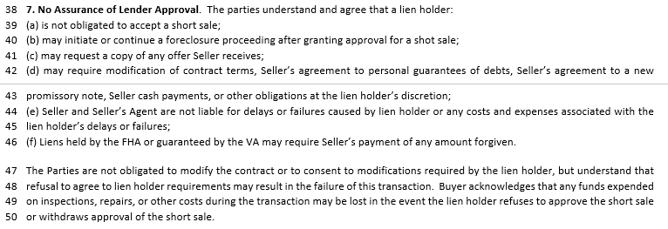
New Form – 4.5 Short Sale Addendum
Lenders only approve if they want to.

Slide 11
New Form – 4.5 Short Sale Addendum
Generally, lenders will want seller to keep marketing so as to find the highest price buyer. Lien holders have much of the power in this arrangement, particularly if there is a previously filed foreclosure action.

Slide 12
Minor Update – 1.1-1.5 Sale Agreements
“Federal Holiday” added to definition of “Business Day” as October 14, Columbus Day, is on federal holiday schedules, but is not an Oregon holiday under ORS 187.010.

Slide 13
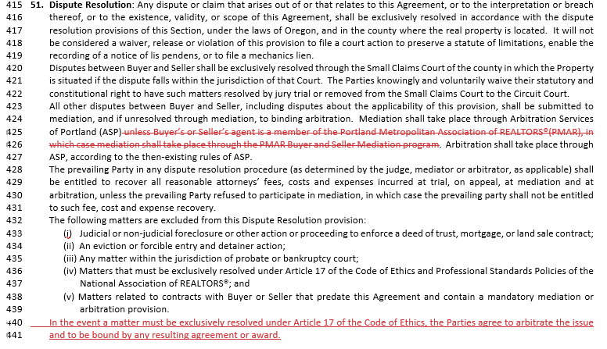
Minor Update – 1.1-1.5 Sale Agreements
As PMAR has shuttered its mediation program and simply sends folks to ASP, this provision is no longer required
Article 17 arbitrations between two or more brokers on things such as open listings are only applicable if the client has agreed to participate in arbitration or requests the arbitration and agrees to be bound by the decision.

Slide 14
Minor Update – 1.2 Commercial PSA
Expiration date placed into Commercial PSA, previously expiration date was an optional addition through additional provisions to accommodate the irregular schedule of commercial negotiations.

Slide 15
Minor Update – 2.11 Notice of Intent
Visual differentiation added to Buyer and Seller notice sections, alongside more straightforward titles.

Slide 16
Minor Update – 2.11 Notice of Intent
Specified that release of contingencies doesn’t otherwise modify sales agreement terms outside applying a requirement for proof of funds/lender financing.
Intent to Terminate no longer a separately shaded section to make it more clear that Buyer selects only one option: intent to proceed under contract, intent to proceed w/release, or intent to terminate

Slide 17
Minor Update – 4.4 Association Addendum
Added clarity about what broad laws things like condo associations and planned communities are defined under.

Slide 18
Minor Update – 4.4 Association Addendum
Added null-set options for users.

Slide 19
Minor Update – 4.4 Association Addendum
Provided additional explanation of the use case for the “does not exist” option within Form 4.4A.

Slide 20
Minor Update – 9.3-9.4A Agency Agreements
OLD
Changes made to address HB 4058 rulemaking.
NEW

Slide 21
Minor Update – 9.3-9.4A Agency Agreements
Minor modification to Dispute Resolution provision to clarify inconsistency of language.

Slide 22
Minor Update – 9.4 Buyer Representation Agreement
The compensation section was updated to clarify that only lines 74-76 are nonactionable upon Buyer’s unilateral termination.

Slide 23
Minor Update – 9.11 Broker Referral Agreement
Optional expiration date on Referral Agreement added.

Slide 24
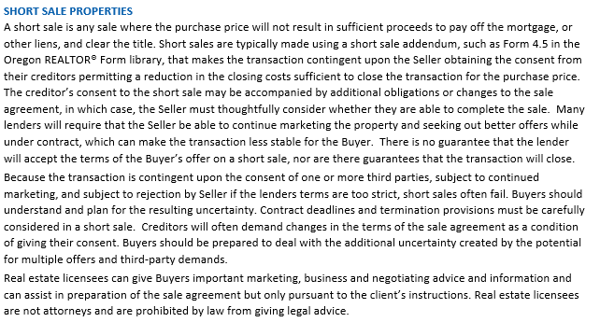
Minor Update – 10.1 Buyer Advisory
Short Sale Advisory language has been expanded.

Slide 25
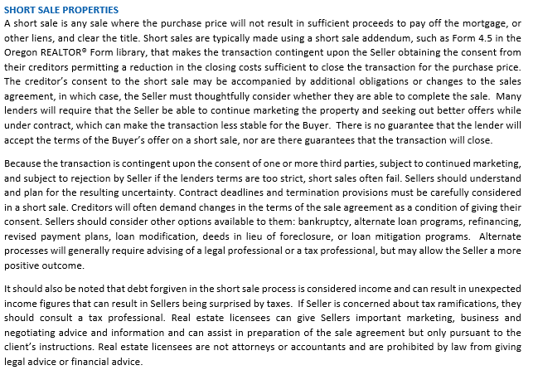
Minor Update – 10.2 Seller Advisory
Similar but more seller-directed Short Sale Advisory language has been added to Seller Advisory.

Slide 26
Questions?

