Slide 1
MID-YEAR UPDATES TO OR FORMS

Slide 2
Updates
Oregon REALTORS® Forms were released in mid February 2023, after 2 years of drafting and a 4 month soft-launch where we received and implemented feedback.
We had been releasing incremental updates until mid-April when the decision was made to do all the updates in one large packet.
Therefore, these updates reflect the past 4.5~ months of comments and requests from members, the task force, and practitioners.

Slide 3
Updates
Many forms did not need updating [e.g. Form 1.1, Residential Purchase and Sale Agreement will not change].
For some updates [Form 1.3 Manufactured & Floating Home PSA] we consulted specialists who work primarily with the form’s subject matter. Most of the specialist advice was to improve quality of life for users, not to make legal changes.
During this training, we will point out the instances where there is a change to the legal impact of the form.

Slide 4
Form 0 – Document Numbering List [table of contents]
Added Form 2.1A Counteroffer onto Oregon REALTORS® Forms
Added Form 4.4A Delivery and Receipt of Association Documents
Added Form 9.9 Addendum for Agent Documents
Changed Title of Form 2.16 from “Seller Occupancy Addendum” to “Seller Occupancy Agreement”
Changed Title of Form 2.17 from “Buyer Pre-Closing Occupancy Addendum” to “Buyer Pre-Closing Occupancy Agreement”

Slide 5
Form 1.2 – Commercial PSA
Added ability to specify Closing Escrow agent
Moved Due Diligence Contingency to be part of the Due Diligence Section:
Updated section numbering to reflect changed numbering.

Slide 6
Form 1.2 – Commercial PSA
Addressed the lack of Offer Deadline:
Default: no expiration date on offer [b/c commercial deals tend to be more fluid and setting hard and fast deadlines where the offer becomes inoperative was counterproductive].
If parties want to add deadline, language now given to explain process.

Slide 7
Form 1.3 – Manufactured & Floating Home PSA
Updated language in Final Agency Acknowledgement:
Removed reference to ownership of slip or space to reflect reality of park ownership [turns out, it’s more like investing in a business and less like owning a condominium].
Updated identification fields:

Slide 8
Form 1.3 – Manufactured & Floating Home PSA
Replaced “Construction” section with “Special Occupancy Requirements” [manufactured homes not constructed, but rather are manufactured, new construction provision not relevant]:
Updated water/sewer section to better match realities of MSD utilities.
Cleaned up language in the “Rental Document Contingency”
Clarified what needed to be in Buyer’s “application materials” and moved timeline for application [now w/in 10 Calendar Days of mutual acceptance, not “at least 10 Calendar Days before Closing”]

Slide 9
Form 1.3 – Manufactured & Floating Home PSA
Added Rent Increase Contingency:
Buyer now set as the default person paying expense of filing transaction documents/tax certificates/title documents. [to reflect standard practice in the industry]

Slide 10
Form 1.3 – Manufactured & Floating Home PSA
Removed all reference to Real Property to reflect the personal property nature of the structure [e.g. “recording” doesn’t happen].
Changed Fixture definition to reflect practice; clarified that the Structure is not considered “personal property” for this agreement:

Slide 11
Form 1.3 – Manufactured & Floating Home PSA
Removed reference to Real Estate transfer fees.
Modified “obligation survive death” provision to reflect that the Buyer’s heirs cannot be obligated to purchase if application for occupancy is denied.
Removed language regarding matters excluded from dispute resolution that was incorrectly imported into the form.

Slide 12
Form 1.5 – Vacant Land PSA
Modified wording in Water/Sewer section to read “Seller represents that Seller has actual knowledge that the Property is or can be connected to:” Original language incorrectly imported with reference to seller knowing about water/sewer hookups to a dwelling, which would not be possible on vacant land.

Slide 13
Form 1.7 – Right of First Refusal
Added wording “during the Term of this Agreement, Seller shall not make offers to sell the Property to third-parties, nor shall Seller make counteroffers on any third-party Offer.”
Loophole existed in Form 1.7 Right of First Refusal where a Seller could affirmatively make offers to bypass First Right language.

Slide 14
Form 1.9 – Invitation to Escalate
Modified Invitation to Escalate to operate as a Seller Counteroffer.
Functionally, this means an Invitation works as a 3 part process: 1. Buyer indicates willingness to approve escalated counter. 2. Seller provides Invitation to Escalate with signature on Seller Escalation Counteroffer section escalating the price, plus evidence. 3. Buyer approves Counteroffer by signing the Invitation to Escalate and escalated terms are legally set.
Added expiration date to Seller’s Escalation Counteroffer.

Slide 15
Form 2.1A – Counteroffer onto Oregon REALTORS® Forms
New form that streamlines a change specifically onto the Oregon REALTORS® Form library:
Process and language of the counteroffer is pre-drafted to ensure successful transfer without mixed form language

Slide 16
Form 2.1A – Counteroffer onto Oregon REALTORS® Forms
Requires the countering party provide an attached Sale Agreement and packet of Addenda as part of the counteroffer. Otherwise all terms of the previous offer are rejected.
Doing this ensures that no form mixing occurs and guarantees the successful change of form library without contractual landmines.

Slide 17
Form 2.4 – Bill of Sale
Now allows for transfer of property at a date other than Closing:
Added Acknowledgement of receipt of property:

Slide 18
Form 2.5 – Repair Addendum Form 2.5A – Notice of Completion of Repairs
Renumbered Form 2.23 Notice of Completion of Repairs as “Form 2.5A Notice of Completion of Repairs”.
All references to Form 2.23 changed to read “Form 2.5A”

Slide 19
Form 2.8 – Well Addendum
Added “Shared Well Agreements (if any)” to the list of items Seller expected to provide to Buyer.
Added language about optional well testing for community wells.
Capitalized “Promptly”
Added language for Buyer to specify the length of the Well Flow Test:

Slide 20
Form 2.9 – On-Site Sewage Addendum
Capitalized “Promptly”

Slide 21
Form 2.10 – Buyer’s Contingent Right to Purchase
Clarification to ensure parties understand that Third-Party Offers accepted subject to the Buyer’s Contingency will only become valid upon termination of the Buyer-Seller Sale Agreement.
Added “Third-Party Offer may be in the form of a back-up offer” to permit third parties to be accepted as back-ups even if the Buyer Contingency is released.

Slide 22
Form 2.11 – Notice of Intent
Clarified that the Seller triggers the Notice of Intent response requirement only when Seller has signed the Notice of Intent and delivered it to Buyer.
Triggers the “election deadline” only if the Seller has signed the Notice of Intent [the Buyer can independently give the Notice of Intent, this is meant to clarify that the Buyer-Notice of Intent does not trigger the Election Deadline.

Slide 23
Form 2.12 – Seller’s Contingent Obligation to Sell
Added flexibility to the trigger points of the Contingent Obligation to Sell [used to revolve around Seller closing on replacement property]
Added an “other” category for Sale Agreement Timelines:

Slide 24
Form 2.13 – Wood Stove Addendum
The www.epa.gov/burnwise hyperlink somehow linked to www.epa.gov/burnwise.ato. We really don’t know how it happened but the hyperlink now leads to the correct webpage [not the .ato page].

Slide 25
Form 2.16 – Seller Occupancy Agreement Form 2.17 – Buyer Pre-Closing Occupancy Agreement
Changed the header, title, footer, and all references to read “Seller Occupancy Agreement” and “Buyer Pre-Closing Occupancy Agreement” rather than “Occupancy Addendum.”
Since these things are documents that can stay alive after termination of the contract, they are better understood as living agreements than as addendums.

Slide 26
Form 2.21 – Back-Up Offer Addendum
Since the Back-Up and the Primary Offer may be on different form libraries, we added flexibility to the “required documents” references.
Now it reads “(or their equivalent if Primary Contract used a different form library)”. A termination is a termination regardless of what library it comes from. A “rose-by-any-other-name-smells-just-as-sweet” type thing.

Slide 27
Form 3.1 – Seller Property Disclosure Statement
Moved the * from the end of the question to after the “Yes” answer.
Attachment page on the end of the SPDS labeled “3.1A” and no longer a general use document [applies specifically to 3.1]
Form 3.1A now a single page document. For extra space, use Form 3.4

Slide 28
Form 3.2 – Agricultural Land Disclosure Statement
Moved the * from the end of the question to after the “Yes” answer.
Attachment page on the end of the SPDS labeled “3.2A” and no longer a general use document [applies specifically to 3.2]

Slide 29
Form 3.3 – Vacant Land Disclosure Statement
Moved the * from the end of the question to after the “Yes” answer.
Attachment page on the end of the SPDS labeled “3.3A” and no longer a general use document [applies specifically to 3.3]

Slide 30
Form 4.4A – Delivery and Receipt of Association Documents
New form, helps Seller create a paper trail showing what documents they have delivered. Assists the Buyer in understanding which documents have been delivered.

Slide 31
Form 4.4A – Delivery and Receipt of Association Documents
Contains acknowledgement information as well.

Slide 32
Form 8.1 – Seller-Carried Addendum
Reference to “Purchase Price” changed to read “Seller-Carried Loan Amount” to permit instances where only a portion of the Purchase Price is Seller-Carried.
Added space for parties to specify party receiving payments [should be escrow, could be an attorney]

Slide 33
Form 9.3 – Listing Agreement
Added space for Broker to be added to “Parties to this Agreement” section. [originally it was just Brokerage, PB, and Seller]
Clarification added to show brokerage’s exclusive right to sell.
Language modified throughout to make reference to “Seller’s Agent” a reference to Brokerage and Broker alike.
Listing Agreement now set to begin “when signed by all parties” rather than upon the more nebulous “effective date” [legally, effective date would have always been when signed by the parties unless the parties specified otherwise]

Slide 34
Form 9.3 – Listing Agreement
Reference to Listing Price heavily modified to disconnect it from Brokerage Fee. Fee now based on “Gross Sales Price”

Slide 35
Form 9.3 – Listing Agreement
Added space for Broker to sign the Listing on their own and on behalf of the Principal Broker:

Slide 36
Form 9.7 – Conflict of Interests Disclosure
Added “Other” checkbox
Added client approval/acknowledgement [expressly says “it’s okay to continue the agency relationship if they sign here”]

Slide 37
Form 9.9 – Addendum for Agency Documents
New form, functionally just a general addendum where the terminology has been unlinked from the Sale Agreement and made more relevant to the agency documents.

Slide 38
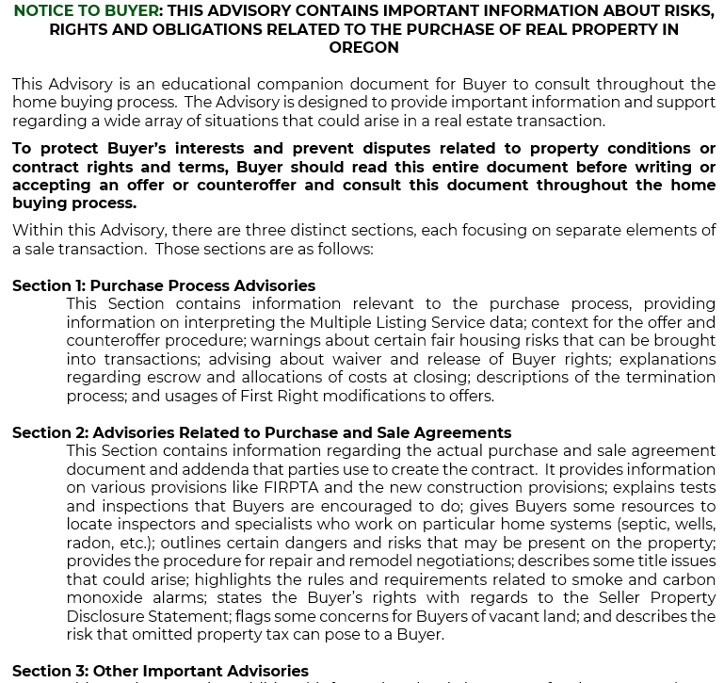
Form 10.1 – Buyer Advisory Form 10.2 – Seller Advisory
Font style changed, formatting brought in closer, removed initial blocks from bottom of pages.
Added explanatory “summary” page before table of contents.
Updated references to other Oregon REALTOR® forms.

Slide 39
Questions?

